Slide 1
PROMINENCE PROmoting MINndful ENCounters through intercultural Competence and Experience
Dr. Troy B. Wiwczaroski, Associate Professor
October 2019

Slide 2
3 Intensive Programmes
Languages and Cultural Diversity (Bratislava, 2018), Managing and Leading in Different Cultures (Aschaffenburg, 2019) and Practising Cultural and Emotional Intelligence across Cultures (Annecy/Savoie, 2020)

Slide 3
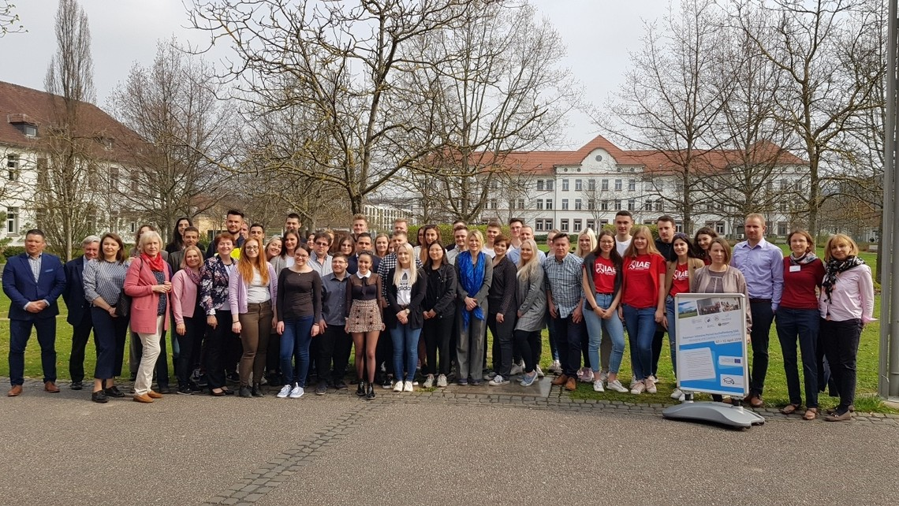
3 Surveys
Students – over 700 responses
SMEs – over 300 responses
Teachers – January-February 2020
Statistical analyses and evaluation
Used in course materials development
To be published

Slide 4
PROMINENCE Interactive Website
www.prominenceproject.eu
E-book
Course materials
Teacher and Student study guides
Full Teacher Class preperation notes

Slide 5
The road ahead
2 Book publications
International Conference
in Seinäjoki, Finland
Finalisation of materials
Quality Assessment
Ongoing Dissemination Activities

Slide 6
For more information, please contact: troy.wiwczaroski@econ.unideb.hu

