Slide 1


STUDENTS’ PERCEPTIONS OF THE
OTHER IN A TELECOLLABORATIVE PROJECT
A virtual exchange project (Colombia-Germany)
Alice Gruber and Brigitte Brath
Promidence final conference, 19th NOVEMBER 2020

Slide 2

● Definition + Purpose of Telecollaboration
● Project
● Results
● Conclusion and Implications
Overview

Slide 3

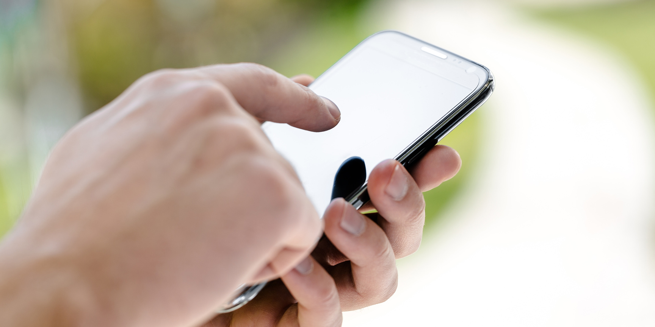
Telecollaboration or virtual exchange refers to groups of learners who, under the guidance of educators and facilitators and as a part of their curriculum, engage in intercultural interaction and collaboration with partners from different cultural backgrounds (O’Dowd, 2018).
VIRTUAL EXCHANGE (VE)
The goal is to model and encourage deeper reflection (Godwin-Jones, 2019)

Slide 4

Advantages
  opportunity to “negotiate each other’s understandings of the other’s culture and their own in ways that would be almost impossible without the technology” (González-Lloret 2020, p.71).
  can help students realise that their international partners are individuals and that they do not always show national characteristics (Avgousti, 2018)

Slide 5
  The ability to collaborate is an essential skill in the 21st century (Partnership for 21st Century Skills, 2008)
Advantages
  skills necessary in the 21st century: teamwork and leadership
  can facilitate the acquisition of language competence , intercultural understanding and the skills regarding digital and electronic communication

Slide 6
STUDENTS’ PERCEPTIONS OF THE
OTHER IN A TELECOLLABORATIVE PROJECT
Colombia and Germany
Project

Slide 7




Set-up and participants
  NNS-NNS
  summer term 2019 /
  winter term 2019–20
  weekly assignments
  video conferencing
  two cohorts
  54 students in total
  average age Colombia: 19.4/ Germany: 23
  different majors
DEMOGRAPHIC SURVEY
POST SURVEY

Slide 8

(OVER) GENERALISATION
I think the project helped us to realise that
foreign people are not too formal and strict like we think.
People from other countries tend to be shy.
References such as “foreign people” and “people from other countries”, meant that their statements were not culture-specific and they also conveyed a “we–they” dichotomy (Ladegaard, 2011).
Results:

Slide 9
DIFFERENCES
We interacted with people who have different ways to see life.
Germans have so many behaviours different from Colombians (that's an enriching experience).
It was mind-blowing to see how different our cultures and countries are.
Results:

Slide 10
REFLECTION ON THEIR OWN CULTURES/
INTERCULTURAL ENCOUNTERS
Results:
I am more aware of the fact that nothing always can work like the “German” way. (German student)
Compromise is a valuable option when dealing with other cultures, particularly when facing major problems.
When dealing with someone of another culture you have to be very careful and try not to hurt any feelings.

Slide 11
LEARNING OPPORTUNITIES
The learning experience was more dynamic because we have different opinions with really different points of view.
I learned more about a different culture than I would have learned, if we had just discussed it in class.
[...] a chance for self improvement in dealing with other cultures.
It was a perfect way to learn about communication situations for our job later on, because it was comparable to real situations.
Results:

Slide 12
Conclusion and implications
students’ experiences differed considerably
deeper cross-cultural understanding can only occur if students, along with their teachers, attend to it. (Caluianu, 2019)
VE: valuable in supporting the students
to develop skills and empathy
students may become more aware of the differences in discursive practices (Oskoz & Gimeno-Sanz, 2019)

Slide 13

FINAL QUOTE
  The whole experience was very impressive. I was a little sceptical in the beginning, to be honest. But [...] it was a lot of fun throughout the meetings. Walter, Maria Jose, Florian and I had very good conversations and we've learned a lot about the other country, even about our own country. We even decided to meet some day, if Corona allows it.

Slide 14
CONTACT
Alice Gruber: alice.gruber@hs-heilbronn.de
Brigitte Brath: brigitte.brath@hs-heilbronn.de
Acknowledgement
We would like to thank our colleague Angela Bailey for her support in carrying out the project.

