Slide 1
KiVAKO Project
The Next Step:
From Language Fluency to Cultural Fluency
Heli Simon, Seinäjoki University o Applied Sciences
19.11.20

Slide 2
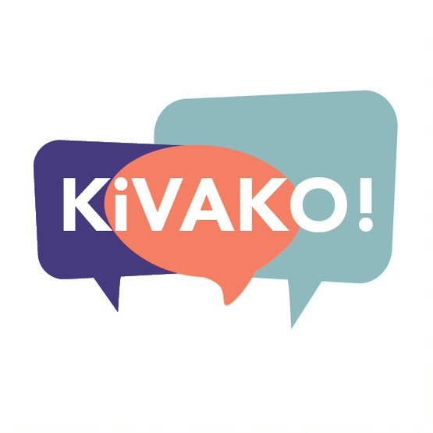
KiVAKO project (2018 – 2021)
“Strengthening the language reserve at higher education institutions”
Financed by the Ministry of Education and Culture
Online courses in Spanish, Italian, Portuguese, Russian, Estonian, German, Japanese, Chinese, Korean and sign language
UniTandem
Open-access study paths from CEFR level A1 to C1

Slide 3
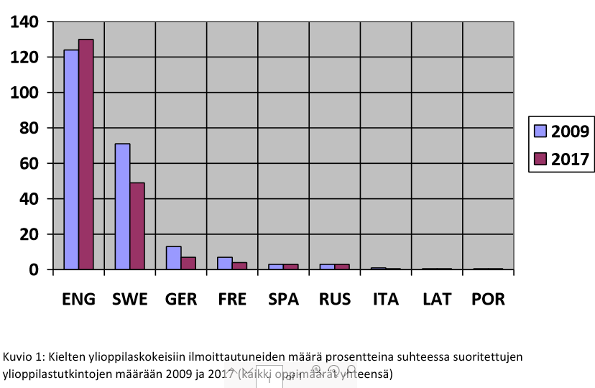
Matriculation exams in languages
2009 and 2017

Slide 4
Background
Need for diverse language and cultural skills
2017 an investigation into the state of Finnish language reserve, language levels and development needs

Slide 5
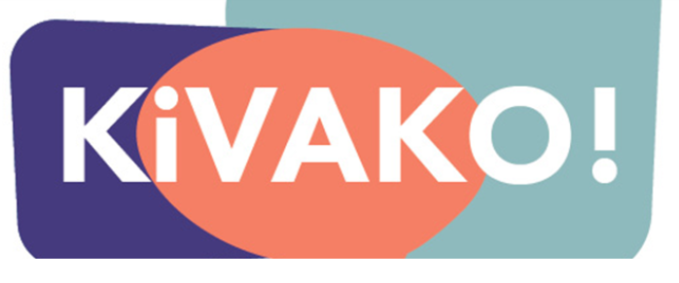
KiVAKO courses
Online courses
with traditional online course elements
communicative elements
    Spoken pair exercises
    Small group discussions
    Presentations
    Recording speech and discussions

Slide 6
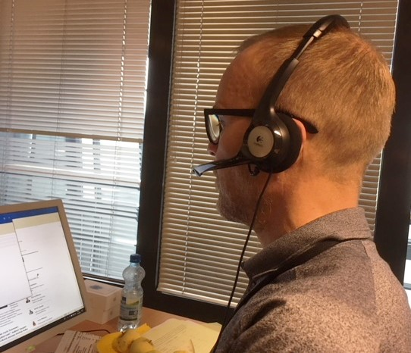
Managing language intensive work life
Will students / future employees
handle language intensive tasks?
cope with multilingual and multicultural teams?
understand that there is no one “normal” way of doing things?
have the ability to communicate or behave in ways that facilitate understanding?
be aware of possible communication challenges?

Slide 7
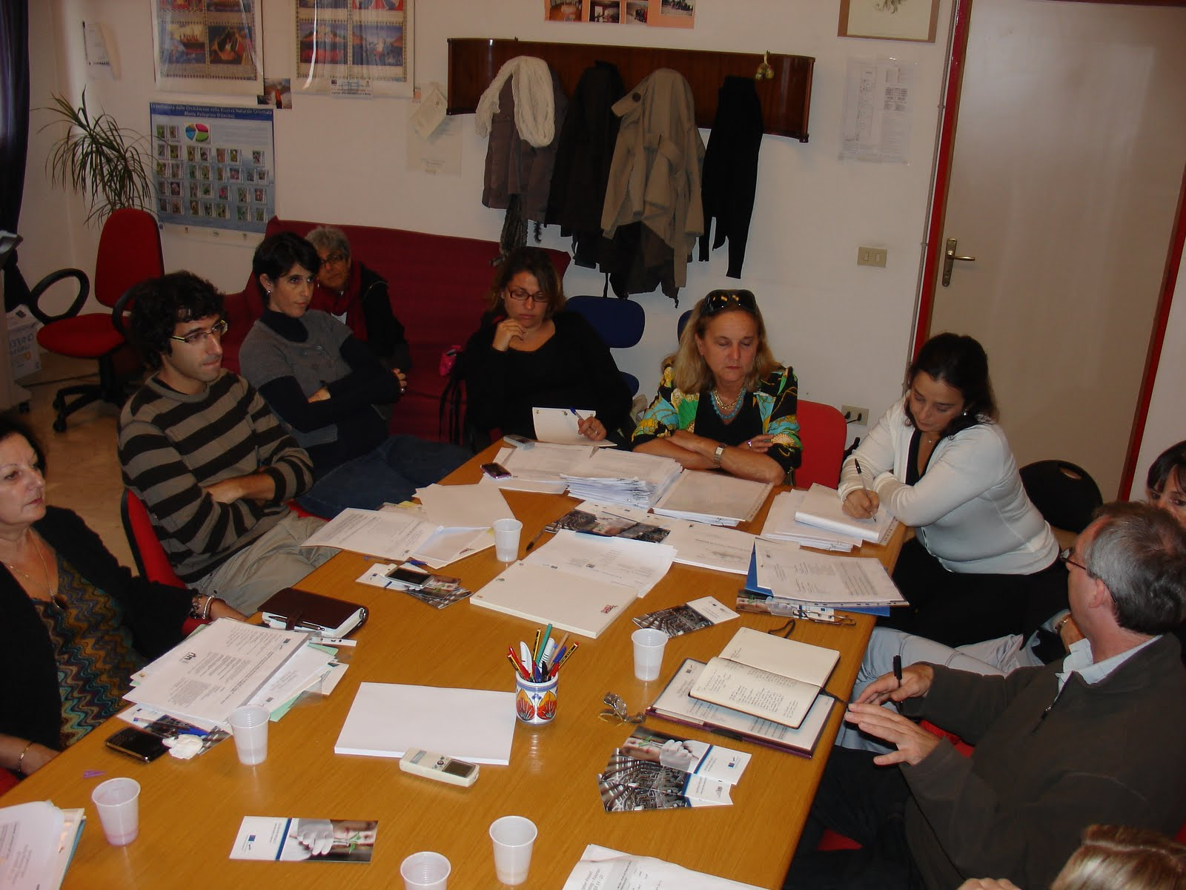
Challenges
Language learning - a complex social practice
Discovering cultural differences
Social interaction
Reflection on experiences of difference
Responsibility for respectul communication

Slide 8
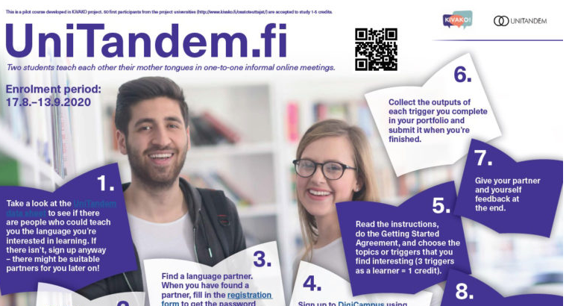
Future KiVAKO courses
Potential of UniTandem
Intercultural competences on the CERF level A

Slide 9
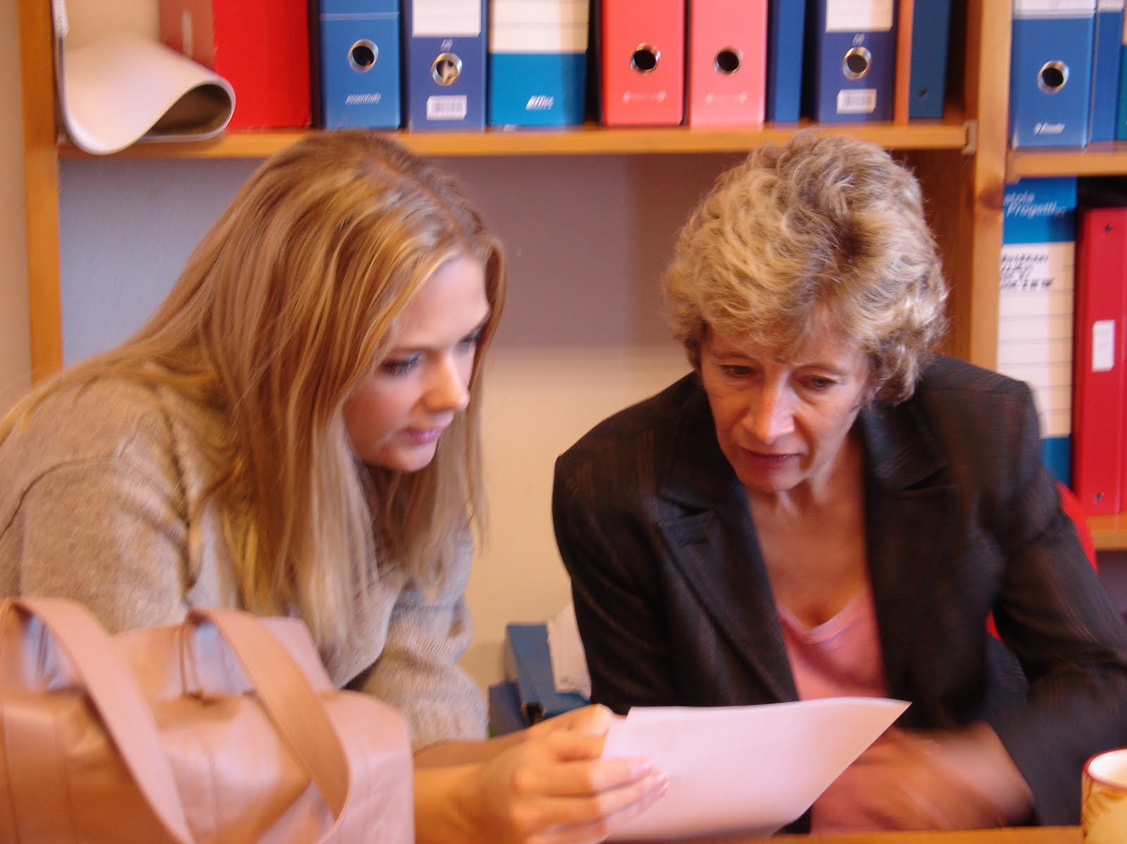
How are future language classes?
Role of translation tools
Speech recognition
Communication via online channels

Slide 10
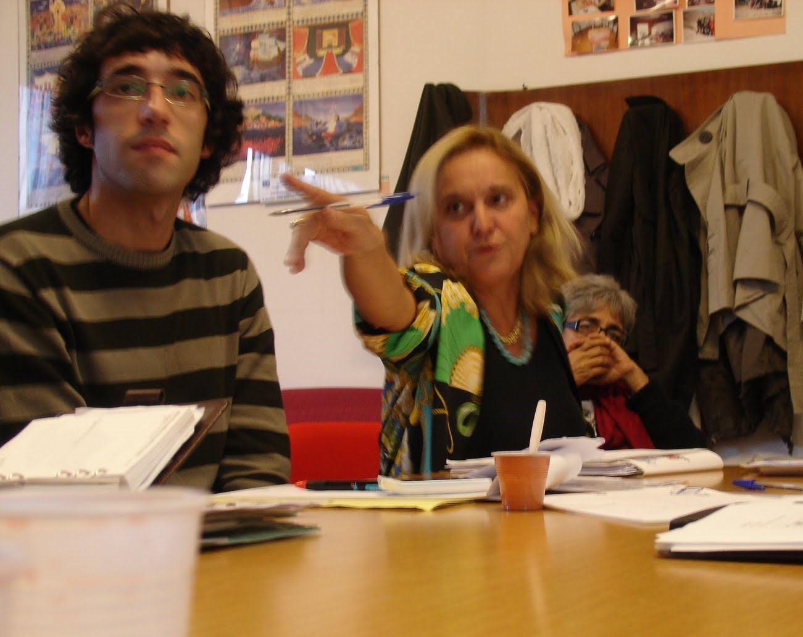
Conflicts in communication
will not disappear
will not be solved with IT solutions
may be solved with skills in intercultural competence

