Slide 1
Prominence Final Conference | 19.11.2020
VISUALIZING CULTURAL EMOTIONAL INTELLIGENCE LITERATURE: A BIBLIOMETRIC REVIEW FROM 2001 – 2020
Sunday Adewale Olaleye
University of Oulu,
Department of Marketing, Management and International Business,
Oulu Business School, Finland.
sunday.olaleye@oulu.fi

Slide 2

Introduction
Research Question
Methodology
Results
Conclusions

Slide 3
Introduction
The emotional intelligence literature is advancing in the different research domain, and its impacts and application to the real-life situation are remarkable.
Fifteen (15) years ago, emotional intelligence as a concept from organizational and psychology research was a controversial issue among scholars.
Despite the prolonged divided views, publication, citation and readership of emotional intelligence is increasing.

Slide 4

Research Question
This bibliometric review intends to answer the following research question: What is the effect of emotional intelligence centrality to cross-cultural, sustainability, cross-cultural adjustment and creative performance?

Slide 5
This study employed the keyword of ‘cultural emotional intelligence’, and it generated 502 academic works, which consist of journals, book chapters, and conference proceedings.
This study reduced the papers the Web of Science search engine displayed to 375 articles. Besides, the author examined the title of the papers, abstract, and excluded the articles that are not relevant and streamline the articles to 130.
This bibliometric review presents a network analysis of the emotional intelligence research domain utilizing VOSviewer software (Van Eck and Waltman, 2013) for bibliometric data mapping for the articles published from 2001 to 2020.
Methodology

Slide 6
Bibliometric methods and systematic workflow
Step 1: Research Design
* Decide on your research question.
* Decide on quantitative type: Descriptive, Correlational, Multidimensional Scaling (MDS), Principal Component Analysis (PCA), Cluster Analysis, Network Analysis [bibliographic coupling, co-word, co-author, co-citation, direct citation]. Specific data analysis technique or mixed technique to tackle your research question(s)?
Step 2: Bibliometric Data Source
* Decide on the appropriate database [Social Sciences Citation Index (SSCI), Scopus or others].
* Search, filter and export bibliographic data [search criteria with best practices, selection of relevant journal, different criteria filtering - research context, citation.
Step 4: Data Visualization
* Decide on visualization method (Refer to step 1 for a choice).
* Decide on the appropriate software that align with your visualization method. Check appropriate software in step 3.
Step 5: Result and Interpretation
* Present your results in tablets and figures.
* Describe the insights from your results and interpret the findings.
*Apply your findings.
Step 3: Bibliometric data analysis
* Decide on appropriate software with precision for the first stage analysis [VOSviewer, BibExcel, HistCite, CiteSpace, Pajek, PoP (Publish or Perish, UCINet, Netdraw, Gephi, Bibliometrix package of R and many more].
* Decide if second stage analysis with the result of the first stage is necessary or not. If necessary, think on software like [Excel, SPSS, Minitab, STATA, NVivo and others].
* Data cleaning.
* Conduct your desire bibliometric analysis.
Step 6: Conclusion
* Summarize your findings.
* Write the limitation of your study.
* Propose future study.
* Capture only relevant reference materials.

Slide 7
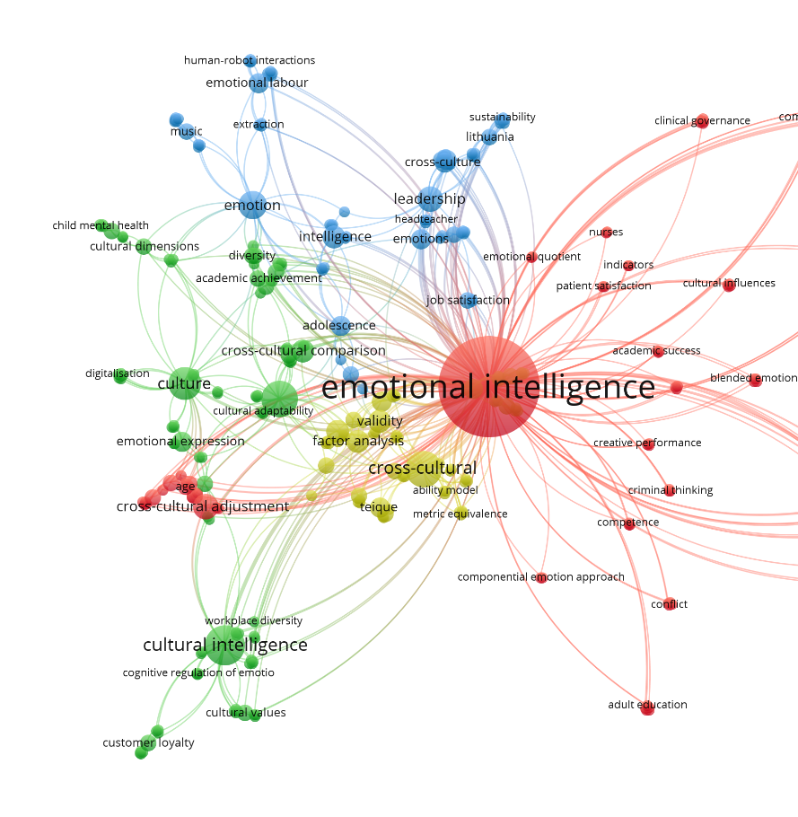
Frequency of Authors Keywords

Slide 8
Results
Bibliometric Clustering of Emotional Intelligence Literature

Slide 9
Selected top journals and the highly cited articles in cultural emotional intelligence (2001 – 2020)
Results
Outlet | TC | AIS | RIF (2019) | Categories | PFI/Year
European Journal of Personality | 453 | 2.334 | 3.910 | Psychology, Social | 6
Organizational Behavior and Human Decision Processes | 130 | 1.907 | 2.304 | Psychology, social, applied, management | 6
Personality and Social Psychology Bulletin | 104 | 1.865 | 2.970 | Psychology, social | 12
Journal of Social Issues | 97 | 1.138 | 2.483 | Social Issues | 4
International Journal of Nursing Practice | 87 | 0.363 | 1.133 | Nursing | 6
Human Development | 83 | 1.071 | 1.893 | Psychology, Developmental | 6
Personality and Individual Differences | 70 | 0.822 | 2.311 | Psychology, Social | 16
Psicothema | 66 | 0.560 | 2.632 | Psychology, Multidisciplinary | 4
Emotion | 66 | 1.693 | 3.177 | Psychology, Experimental | 8
International Journal of Psychology | 63 | 0.678 | 1.255 | Psychology, Multidisciplinary | 6
TC: Total citation; AIS: Article Influence Score; RIF: Recent impactor factor; PFI: Publication Frequency Issues.

Slide 10
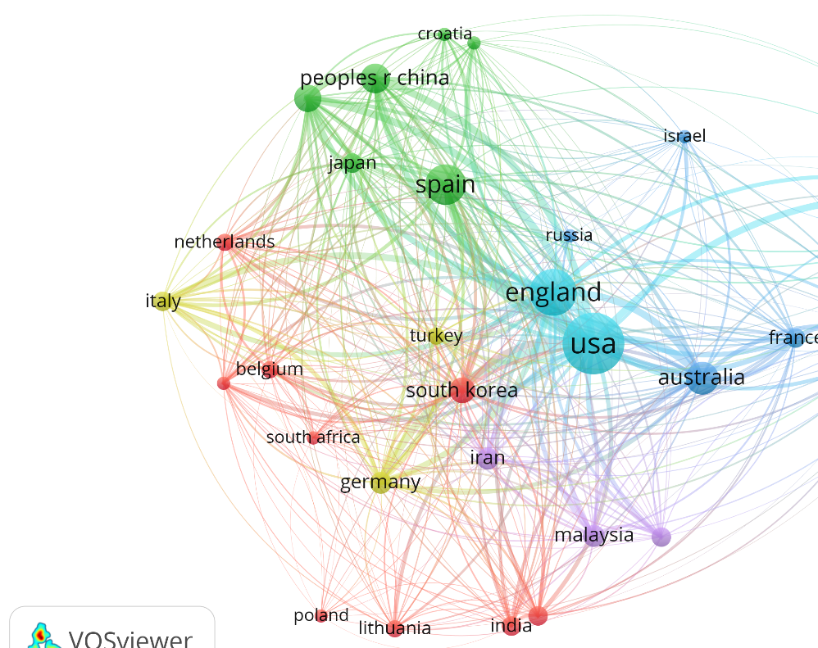
Co-authorship network of the top countries in cultural emotional intelligence

Slide 11
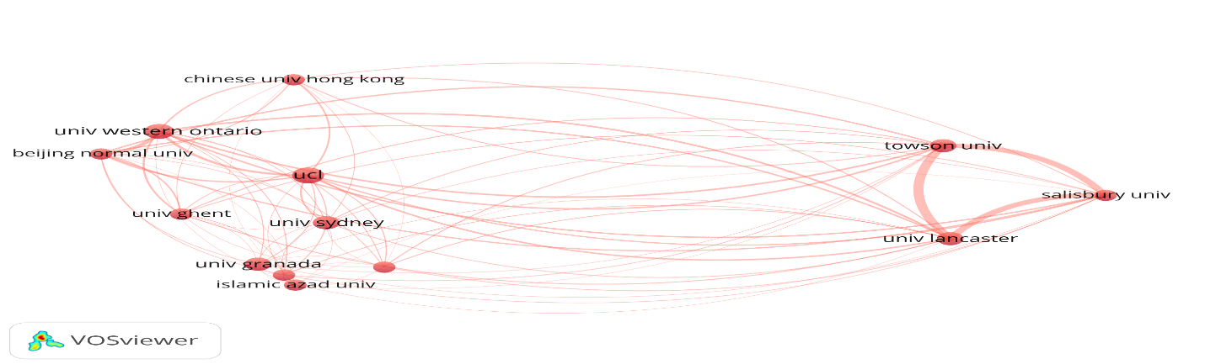

Co-authorship network of the top institutions in cultural emotional intelligence

Slide 12
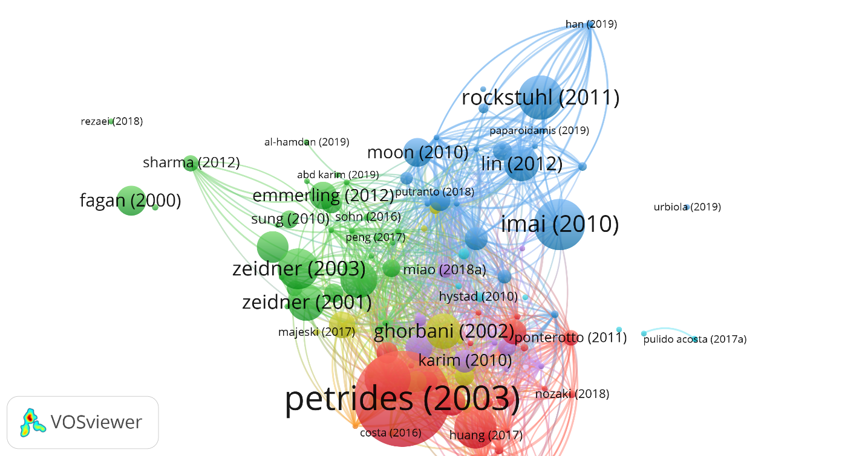
Co-authorship network of the productive authors in cultural emotional intelligence

Slide 13
Results
The total of the 130 articles citations accounts for 2,145 with 16.5 average citations per item and h-index 23.
This metrics shows the visibility of cultural, emotional intelligence.
As a single item, European Journal of Personality had 3.910 recent impact factor, 2.334 article influence score, psychology and social category and producing six publication frequency issues per year.

Slide 14
Conclusions
The study established the importance of emotional intelligence literature and the centrality of emotional intelligence to cross-cultural communication, sustainability, creative performance and cross-cultural adjustment.
This study will help the researchers to discover publications, institutions and country gaps.

Slide 15
Limitations and Future Study
This study data extraction limits to 130 documents despite the significance of the study.
The future researchers should take this study further and endeavour to gather more samples and probably compare between different academic databases apart from the Web of Science.

Slide 16


Slide 17


